Slide 2
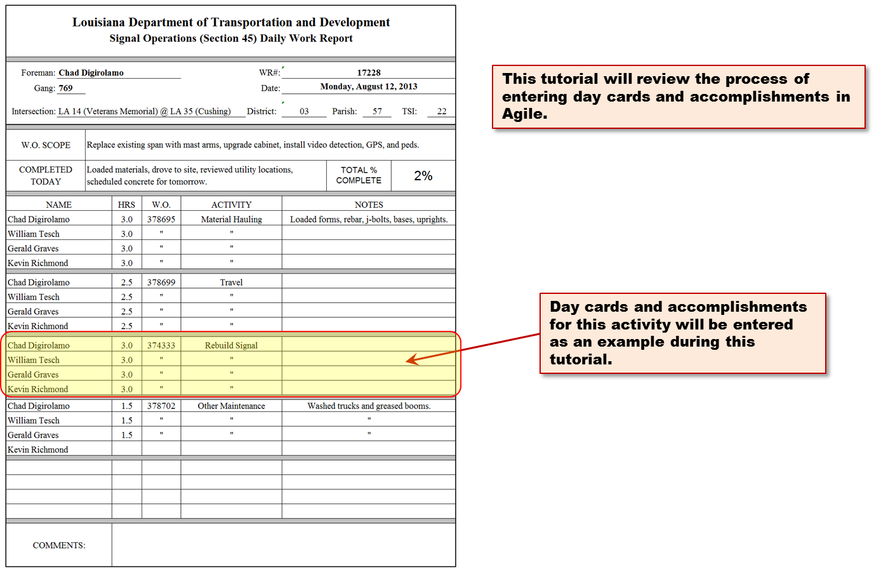
HOW TO ENTER SIGNAL DAY CARDS AND ACCOMPLISHMENTS

Slide 3
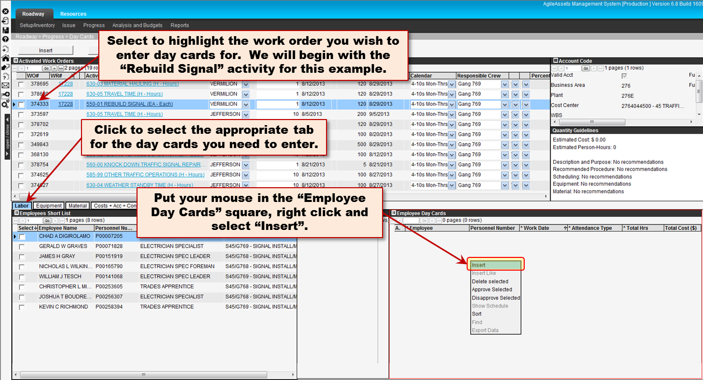
HOW TO ENTER SIGNAL DAY CARDS AND ACCOMPLISHMENTS

Slide 4
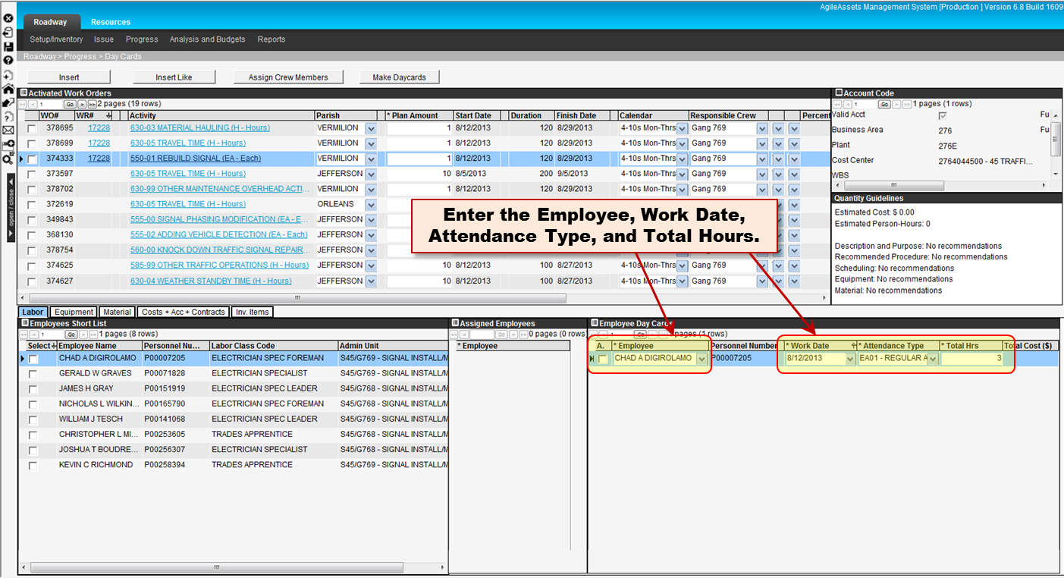
HOW TO ENTER SIGNAL DAY CARDS AND ACCOMPLISHMENTS

Slide 5
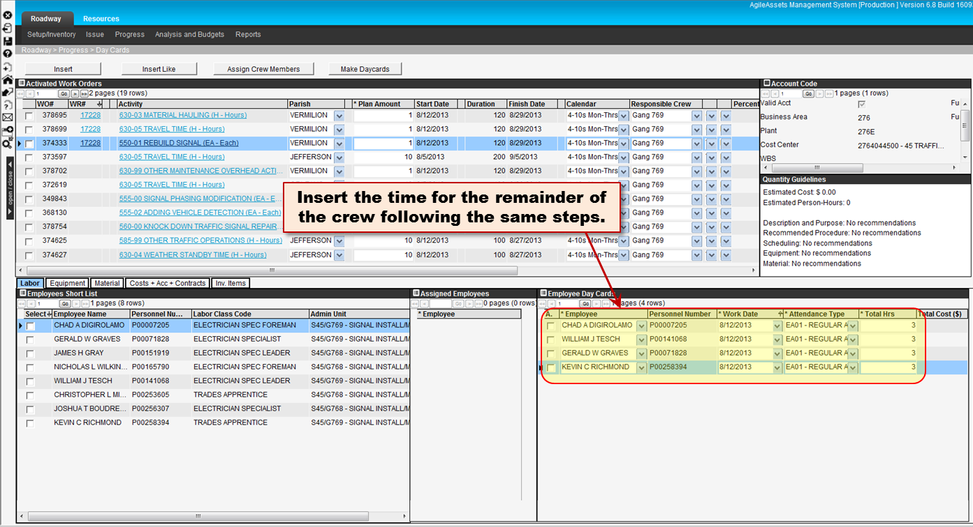
HOW TO ENTER SIGNAL DAY CARDS AND ACCOMPLISHMENTS

Slide 6
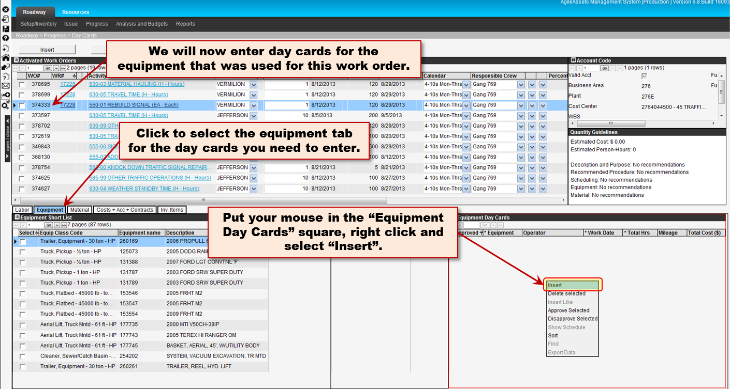
HOW TO ENTER SIGNAL DAY CARDS AND ACCOMPLISHMENTS

Slide 7
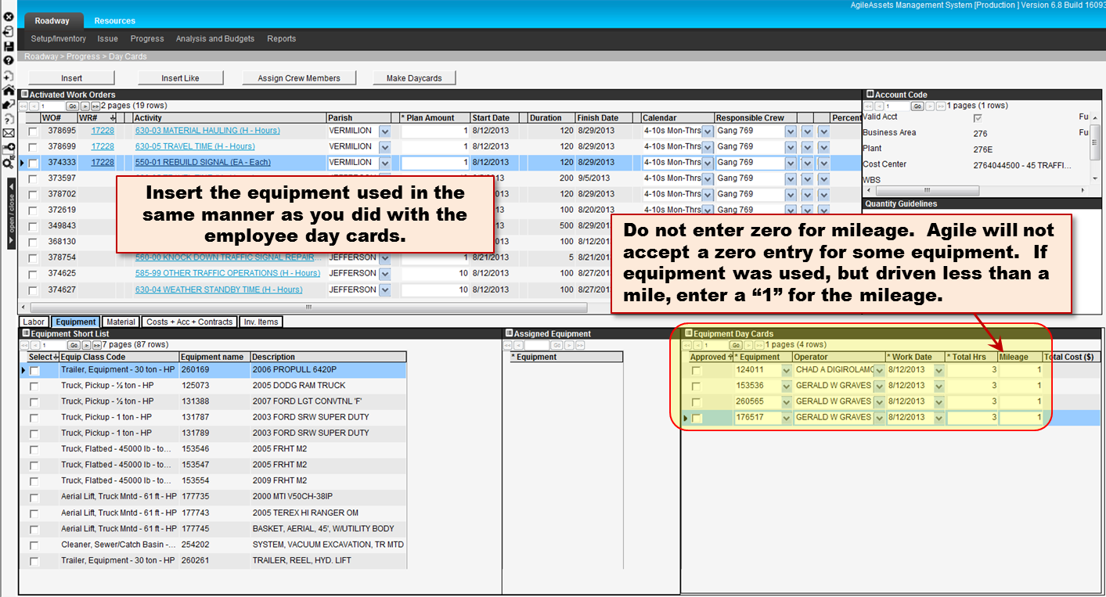
HOW TO ENTER SIGNAL DAY CARDS AND ACCOMPLISHMENTS

Slide 8
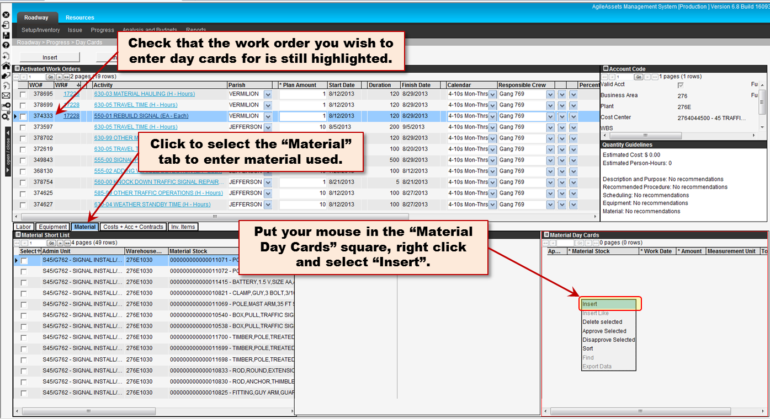
HOW TO ENTER SIGNAL DAY CARDS AND ACCOMPLISHMENTS

Slide 9
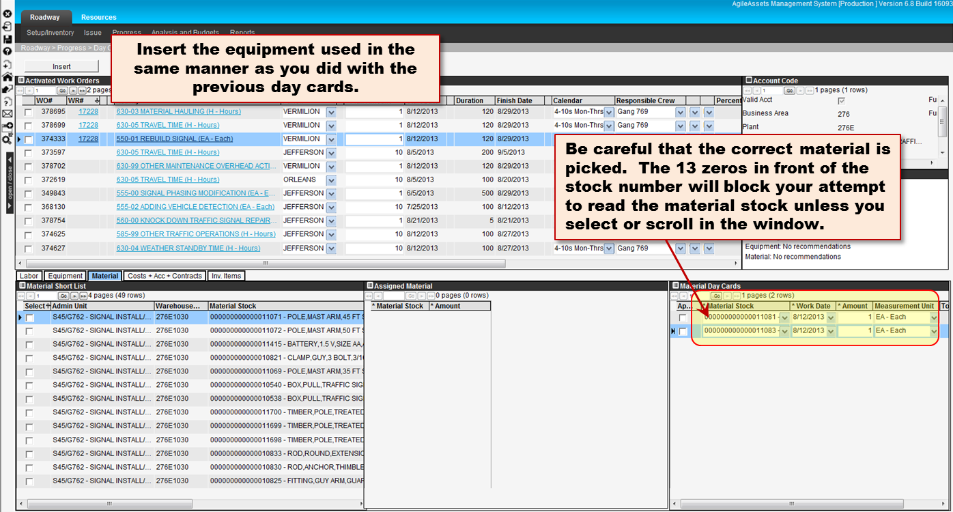
HOW TO ENTER SIGNAL DAY CARDS AND ACCOMPLISHMENTS

Slide 10
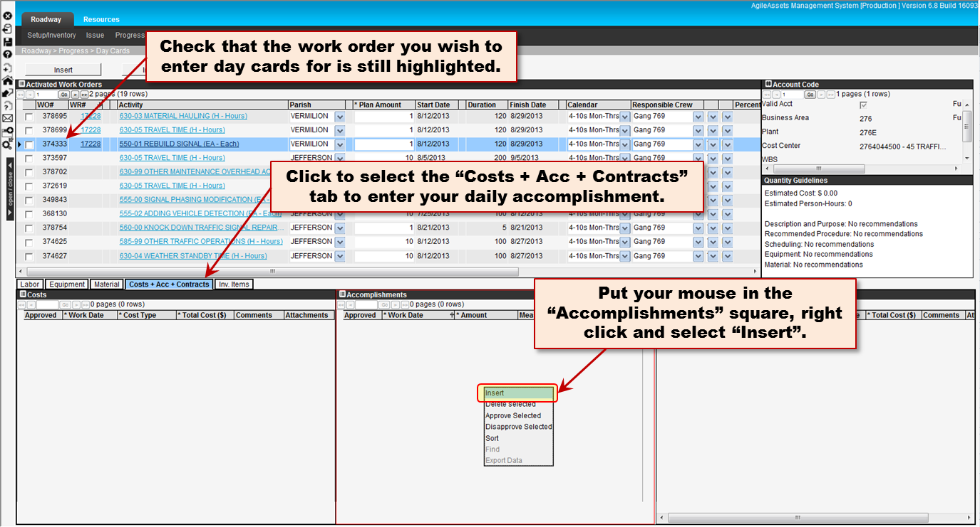
HOW TO ENTER SIGNAL DAY CARDS AND ACCOMPLISHMENTS

Slide 11
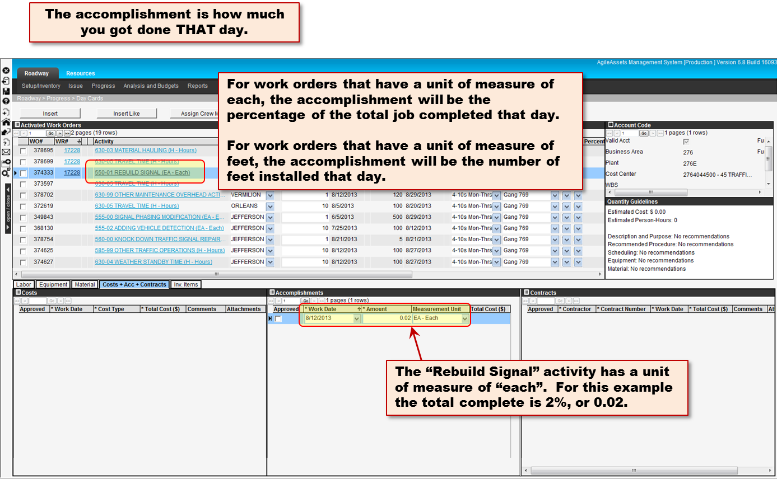
HOW TO ENTER SIGNAL DAY CARDS AND ACCOMPLISHMENTS

Slide 12
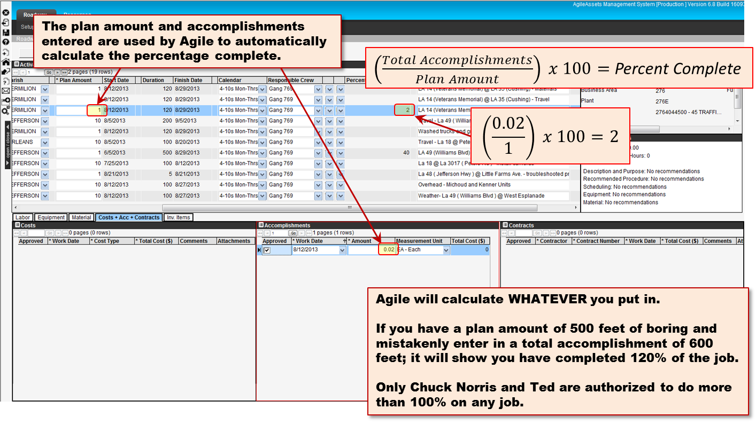
HOW TO ENTER SIGNAL DAY CARDS AND ACCOMPLISHMENTS

Slide 13
HOW TO ENTER SIGNAL DAY CARDS AND ACCOMPLISHMENTS

